Slide 1
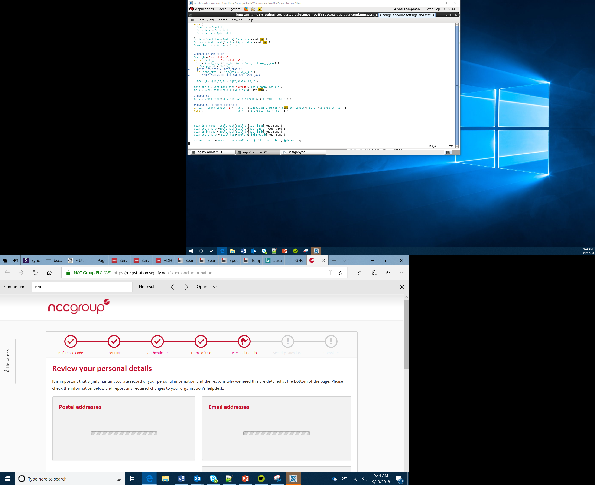

Images, Variables and Functions
Lesson 2

Slide 2
What the Lesson Will Cover
What a variable is and a function
How to create a simple image
Creating a simple animation
Notes:
Introduce the lesson content

Slide 3
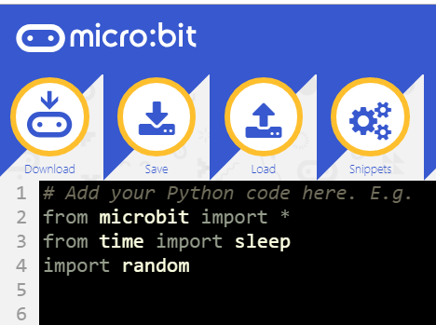
Importing
The import command enables you to import program code to control the micro:bit
The * means import all the modules, for example, LEDs, acceleration, buttons
It is similar to the DLC or upgrade packs you can by for software and games, giving you additional content
To import simply use the command import followed by what you are importing
What do you think these modules do?
Notes:
Explain what ‘import’ a module is, the * means import all the modules, this enable you to code additional features on the micro:bit such as time, maths, LEDs and sound

Slide 4
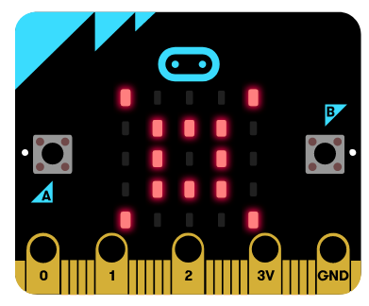
Creating Your Own Image
The micro:bit LED matrix has five rows of five LEDS – 25 in total
Each of the LEDs can be programmed either ON or OFF
You can also set the level of brightness, where 0 is OFF and 9 is full brightness
By turning the LEDs ON and OFF you can build up a simple image
In Python we create a list to hold the data about the LEDs that are used in the image
Notes:
Explain the layout of the LEDs

Slide 5

Creating your own image
Consider the image displayed on the micro:bit
Each row of 5 LEDs has to be programmed, the first line is, "00900:"
Where the 9 represents the middle LED which is turned ON
The next row is represented by "09090:"
Note the use of the : at the end of each line
Each row data is also held between quotation marks " "
Notes:
Explain how the code works

Slide 6
Variables
Writing out the code for an image every time we want to use it is time consuming, therefore we use variables
Variables are storage locations in the micro:bit’s memory that are used to hold data
First a variable is declared by naming it followed by the = sign
In the example program the variable is called dot1
The variable dot1 stores all the data about which LEDs are either turned ON or OFF and the level of brightness
Variables can also store letters, numbers and symbols
dot1 = Image("xxxxx:" "xxxxx:" "xxxxx:" "xxxxx:" "xxxxx")
Notes:
Introduce variables and how they are used

Slide 7
Functions and Arguments
Functions are a simple line of code that contains further instructions or more complex code
Functions mean that you can save time having to write out or duplicate program code, you simply run the function
The display.show() is a function which calls a more complex program code that takes the data about the LEDs, and brightness and then writes this data to the LED display
We pass the data stored in the variable dot1 to the function, so it can run, this is called passing an argument
dot1 = Image("xxxxx:" "xxxxx:"
"xxxxx:"
"xxxxx:"
"xxxxx")
display.show(dot1)
Notes:
Introduce functions and how they are used

